Slide 1

Aruba MOVE™
网随人动
Aruba智慧无线校园解决方案
People move. Networks must follow.™

Slide 2
公司简介

Slide 3


Aruba 是什么公司?
企业级安全移动无线网络
成立: 2002年成立于
美国硅谷
Aruba MOVE
网络架构
2007年
美国纳斯达克上市
业界最安全的WLAN
年营收：10亿美金
业界最易部署实施的BYOD和访客网络
Gartner 魔力象限
连续7年领先地位
“零配置”远程网络接入

Slide 4


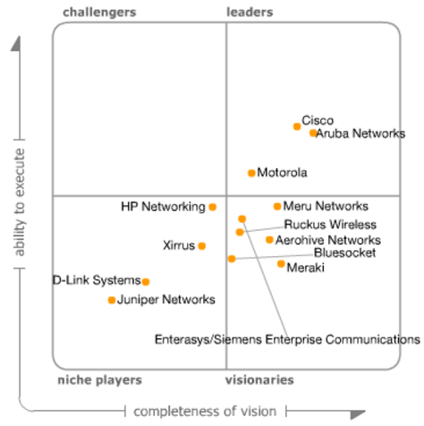
无线领域的地位
Gartner连续7年将Aruba评价为行业的领导者

Slide 5















































































深得全球顶级客户信赖
高新技术
互联网
经融
媒体
高等教育
政府
医疗
零售
基础教育
公共运输
公共组织
服务
能源
制造
酒店
电信运营商
Notes:
6 out of 8 Ivy Leagues
8 out of the Big Ten
The most widely deployed WLAN by the U.S. military
More than 500 major retail chains
Every major social networking company
The world’s largest software companies

Slide 6
国际和国内著名高校案例
英国剑桥大学
加拿大麦基尔大学
加拿大滑铁庐大学
加拿大渥太华大学
日本东京大学
日本早稻田大学
韩国首尔大学
马来西亚伊斯兰大学
……
国立政治大学
台湾大学
澳门大学
岭南大学
香港大学
香港城市大学
香港理工大学
香港中文大学
……
清华大学
北京大学
人民大学
复旦大学
浙江大学
武汉理工大学
福州大学
地质大学
……
上海地区高校行业，超过90%的市场占有率
香港共8所大学，其中7所使用ARUBA解决方案
北美8所长春藤名校中，6所已采用ARUBA解决方案
占全球高等教育行业40%以上的市场份额

Slide 7
校园无线网络的挑战

Slide 8
终端市场大环境的变化
WLAN无处不在
2008年：笔记本电脑的出货量超过台式机，且99%以上内置WLAN网卡
2009年：IEEE 802.11n 标准出台，实现了54M到300M的速度跨越
2010年：Apple推出了WiFi版iPad平板电脑，便携式终端又添新军
2011年：Apple、Android、Microsoft三大系统大行其道，基于这些系统平板电脑和智能手机成为了最主流的数码产品
2012年：BYOD（自携设备）成为流行热词
2013年：Apple推出新版本的iPhone，iPod，iPad，屏幕尺寸更大，连Apple也朝多样化产品线发展
Notes:
8

Slide 9

学生习惯的转变
70后学生：照明好，冬暖夏凉
80后学生：旁边还需要有电源插孔（为笔记本充电）
85后学生：旁边还需要有网口（方便上网）
90后学生：需要有WLAN信号，且信号要好。
Notes:
9

Slide 10
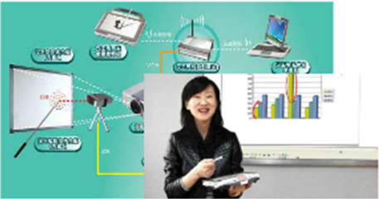
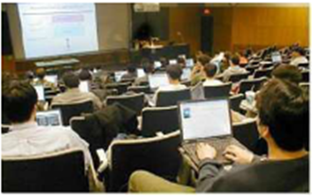
教学方式的改变
无线讲堂：
教师得到摆脱各种连线的束缚，无需将移动范围局限在讲桌一角。
无线多媒体教室：
学生通过无线与老师课件同步，积极参与教学互动，快捷获得教学信息。
Notes:
10

Slide 11
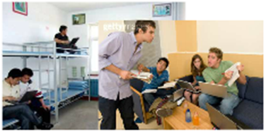
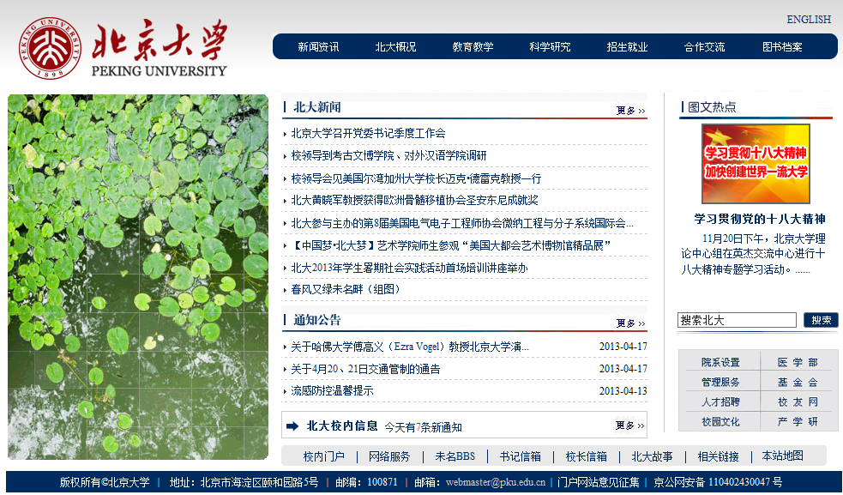
学习方式的改变
移动学习方式：
随时访问教学资源；
更灵活的讨论问题；
更多选学课程。
无线精品课程、VOD：
访问视频服务，点播新闻；
收看教学视频课件。
Notes:
11

Slide 12
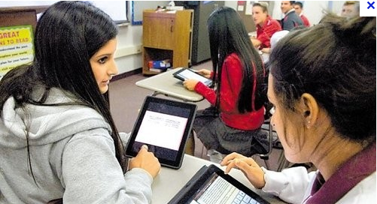
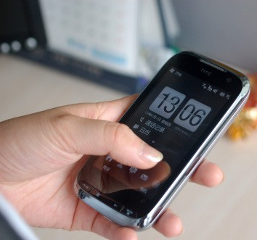
办公方式的改变
OA系统移动处理文件：
教师可以随时随地查阅、审批、处理OA系统的文件，提高办公效率。
移动办公语音电话：
教师利用智能手机或者移动笔记本电脑实现语音通讯；
跳出传统座机电话的约束，不会错过任何校内信息，提高办公效率。
Notes:
12

Slide 13
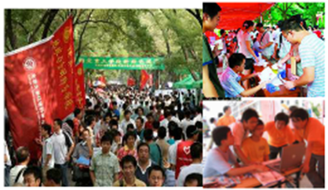

大型活动组织方式的改变
高校现场迎新：
迎新现场无线信号覆盖；
减少部署有线的麻烦；
现场入学信息录入；
新生各项手续现场办理。
企业现场招聘会：
提升学校形象；
方便招聘企业现场信息收录；
方便学生现场掌握企业信息。
Notes:
13

Slide 14
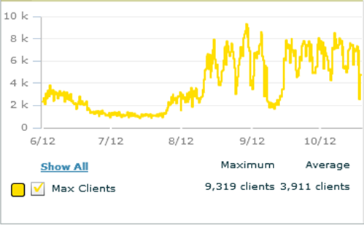
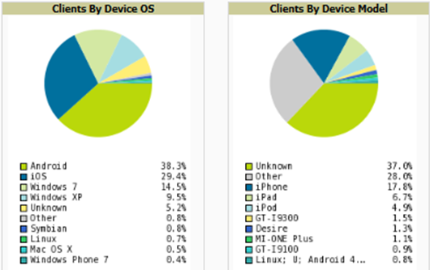
新一代校园网的发展趋势
从终端密度方面分析
终端数量多，增长速度快，峰值并发用户可能超过10,000人
具有相对明确的周期性，寒暑假、长假期间使用量下降
从终端构成方面分析
智能终端占比超过65%
Windows笔记本占比仅25%
智能终端构成以Android和iOS设备为主

Slide 15





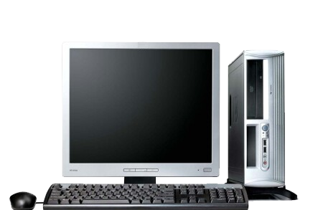
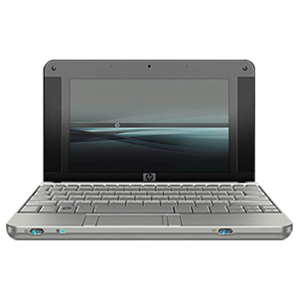
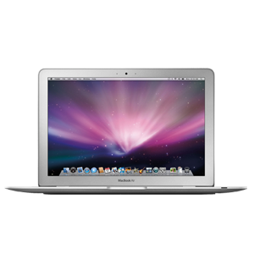
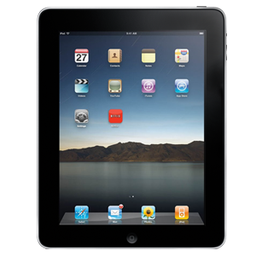
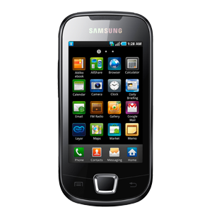
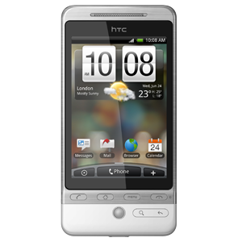
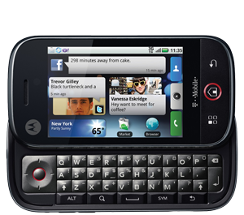
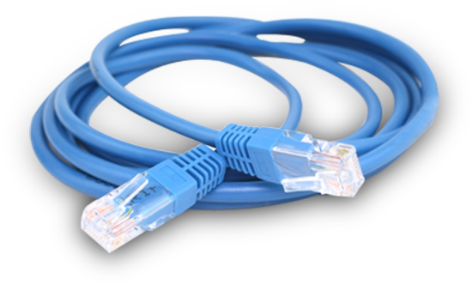

校园网管理工作内涵的改变
从前
现在
移动终端管理
网络端口管理
终端接入管理

Slide 16
^{ARUBA 全新网络体系架构}
^{网随人动}
Notes:
Hello everyone. I hope you are all excited and fired up as much as I am. Let me explain why we are here.
We have had a great 2010 and we are here to discuss what we need to do to achieve higher in 2011. There is a big shift in how enterprises are transforming the way they do business by relying more and more on mobile devices and applications. Enterprise mobility is what we do best. We have a recognized brand in the market place. As a company we have solid financials, a great team, solid products that just work. We are all very passionate about what we do, taking good care of our customers and supporting their enterprise mobility initiatives.
We have a great opportunity to build upon our thought leadership in the market place today when it comes to enterprise mobility, great opportunity to help our customers meet unique set of business objectives. But most importantly we have a great opportunity to sell more products and make more money.
But life is not that easy. We have talked to you about many of these new products in our last sales kickoff. I can assure you that it is not going to be a walk in the park to convince people to invest in these new products. But we believe that we have a great story to tell, and a damn good value proposition for any new and existing Aruba customer.
Two of the main obstacles you are going to be faced with are the following:
From new customers – Aruba is just a wireless LAN provider… what gives you the right to tell me how to design my access network?
From existing customers – Aruba was our choice for 802.11n wireless… aren’t you losing focus by releasing all these products for wired, remote, outdoor?
In order to help you counter these arguments, we have put our existing and new products into one new architecture, called MOVE – the access network architecture for Mobility, designed for the Mobile Virtual Enterprise. MOVE architecture will help IT organizations rightsize their access network spending for mobility and improve service delivery to their mobile workforce, while reducing risk. MOVE will help IT organizations divorce their access networking requirements from their core networking requirements, and take control in putting together a long term mobility strategy.
We have had the opportunity to share this MOVE architecture with some of the customers and analysts – feedback has been great – we have the mindshare and permission.
No better testament than Gartner… here is what the new MQ looks like.

Slide 17











为何信息中心总是头痛?
管理
1
管理
2
管理
3
管理
4
管理
5
分散的网络
孤岛式服务
以Client-Server为中心
无用户和所用设备的单一视图
无情境感知
VLAN
100
VLAN
200
VLAN
300
VLAN
400
VLAN
500
无线
有线
VPN
分公司
室外
“如果不实施一套全面的移动战略，通常会导致更高的成本、更低的安全性、孤岛式解决方案和不必要的重复服务。”
- Gartner, 2010年7月

Slide 18


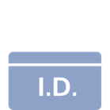

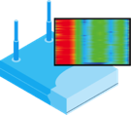


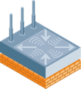

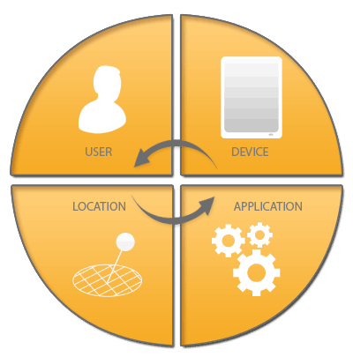





Aruba MOVE™ 基础架构
移动性接入网架构
集成式网络服务
集中控制
  集成式移动服务和“瘦”访问接入
统一访问接入架构
  零接触部署BYOD，语音，视频
情景感知网络
  用户，设备，位置和应用等多维因素的感知
数据中心
“瘦”访问路径
无线
有线
VPN
远程办公
户外
用户
设备
时间/地点
应用
Notes:
Aruba’s MOVE architecture is purposely designed to address these challenges for the enterprise access network. It reacts to the need for transformation at the access layer and meets the need for implementing increased number of mobility services without breaking the bank.
MOVE delivers cloud based mobility services, such as security and location policy, and device, user and network management to the access network. MOVE rightsizes network spend by relying on these cloud services that are available for all types of thin access on-ramps at all locations.
MOVE meets the needs of the IT organizations who need to rapidly deploy and secure new mobility services for the users, such as Bring Your Own Device, multicast video and voice over Wi-Fi.
With MOVE, making changes in the access network becomes a lot easier and prevents errors as the IT managers rely on a single pane of glass for mobility management.
MOVE delivers network security policies and end user applications to wherever the users are, instead of forcing IT organizations build new networks for different types of users and applications.
<click for animation>
MOVE delivers the only context aware access network … one that knows who you are, what device you are using, where you are, what you are doing, and when. The user, device, location and application intelligence is built right into the access network infrastructure. MOVE utilizes the existing network infrastructure for transport and relies on these four attributes to easily deliver mobility services to the end user. Again to re-emphasize, it is the only context aware access network architecture.
So what’s the magic behind all these benefits?

Slide 19

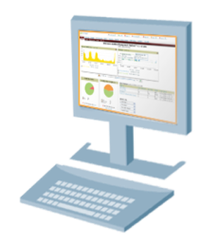





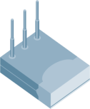




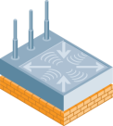

ARUBA MOVE 节省网络建设维护成本
传统解决方案
单一界面
共同策略
接入入口
VPN
节省50%部署成本和75%运营成本

Slide 20
典型场景设计

Slide 21






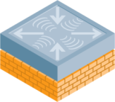









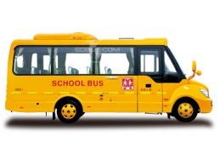
总体架构设计
无线网管
ChinaNet
CMCC
CUC
AireWave
各个运营商
CPE接入设备
网络服务
控制器
Master
控制器
Local
ClearPass
策略服务器
LDAP
数据库
计费系统
校本部
CERNET
3G/DSL
校园核心网络
汇聚层
控制数据流
分校区
分校区
远程接入
控制器
Local
控制器
Local
接入层
无线用户数据流
RAP5

Slide 22
无线网络安全策略设计

Slide 23













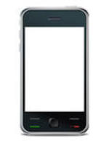





基于用户角色和设备类型的安全策略
Role-Based Access Control
校领导
SSID-Based Access Control
Access Rights
校领导
RADIUS
LDAP
AD
教职员工
Virtual AP 1
SSID1
教职员工
Application
Services
学生
学生
Virtual AP 2
SSID2
WiFi-手机
访客
Secure Tunnel
To DMZ
访客
Captive Portal
WiFi-手机
DMZ

Slide 24
各角色的访问策略建议表
 | 学生 | 教师 | 校领导 | 访客 | WiFi手机 | 运营商用户
时间 | 教学区只允许指定时间上网 宿舍区全天可以上网 | 全天 | 全天 | 全天 | 全天 | 根据跟运营商签订的协议来设置
上网 地点 |  | 所有地区 | 所有地区 | 所有地区 | 所有地区
访问 对象 | 相关教学资源服务器与Internet | 相关教学资源服务器与Internet | 重要数据服务器和Internet | Internet | SIP服务器 | 终端数据只做二层透传，不做安全访问控制
带宽 | 2M | 10M | 10M | 1M | 1M | 根据跟运营商签订的协议来设置

Slide 25
高校应用案例

Slide 26
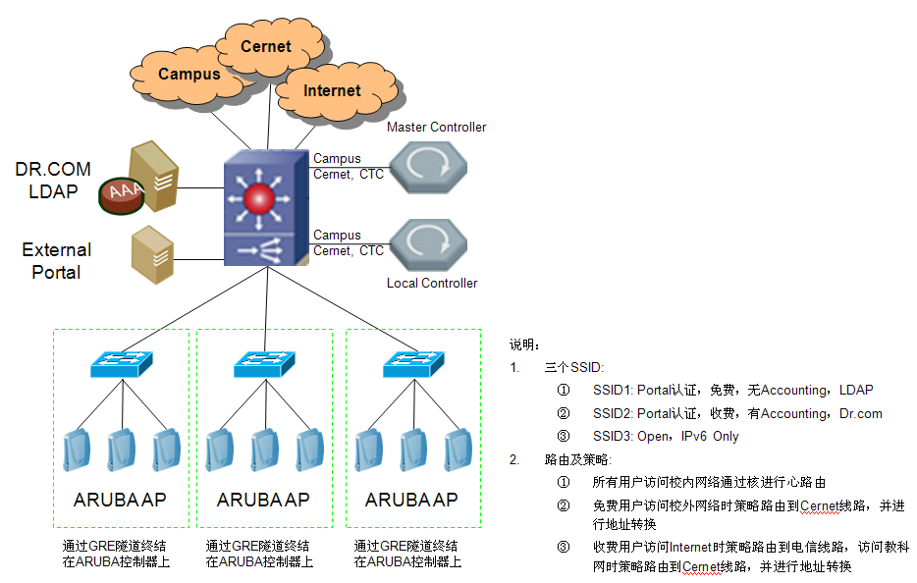
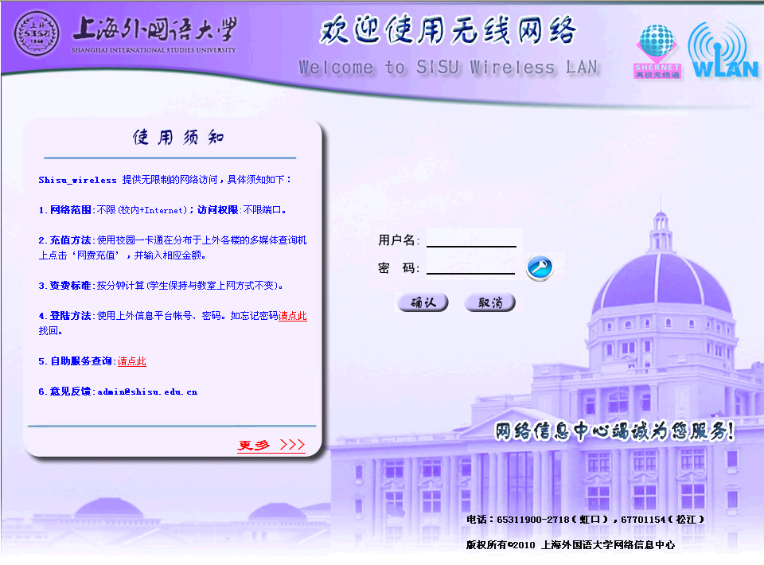
基于用户身份的策略控制——上外案例

Slide 27



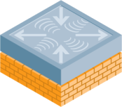

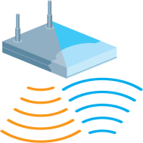
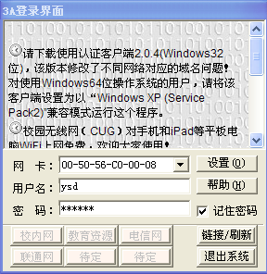

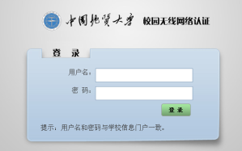

基于终端类型的策略控制——中国地大案例
网络规模：
  4台Aruba6000控制器+1200个AP，最高并发在线用户近3000人
存在问题：
  校园有线和无线用户采用学校自己开发的认证和计费客户端，无法安装在iphone、android、Windows Mobile等智能手机终端上
  传统网络系统无法识别终端类型，并为其分配专门的策略
Internet
认证系统
(Radius, AD)
防火墙
无线控制器
解决方案：
  采用Aruba终端指纹识别技术对智能手机终端进行智能分离，并动态分配新的角色
实现效果：
  笔记本终端只能连接CUG，使用专用认证客户端进行认证，并根据流量进行计费
  智能终端只能连接CUG-Mobile，使用校园LDAP帐号进行Portal认证，不计费，但是对用户的带宽和应用进行限制
核心交换机
无线接入点
ESSID:CUG
ESSID:CUG-Mobile
笔记本电脑
智能终端

Slide 28





基于XML的第三方互操作——武汉大学案例
网络规模：
  4台Aruba6000控制器，6块无线控制模块+1200个AP，最高并发在线用户近6000人
  无线控制器采用 Master-Local 架构实现1:N冗余
  选用3×3:2高性能AP-125无线接入点
无线网络特点：
  Aruba开放的XML用户管理接口为武汉大学实现有线无线统一认证提供保证，XML开放性和灵活性能够确保与各厂商认证计费系统的整合。
  全网实现 基于IPV6的接入和认证。包括IPV6防火墙，IPV6动态路由，IPV6 地址分配，IPV6漫游。
  Aruba基于角色面向用户的网络设计。强大的每用户状态检测防火墙摆脱了基于IP 和VLAN 的管理，真正做到网随人动，策略永相随。
ChinaNet
CMCC
CUC
各个运营商
CPE接入设备
Aruba MMC6000
（3+1冗余热备模式）
10GE
武汉大学校园网络
Aruba
Airwave
千兆
千兆
千兆
PoE交换机
PoE交换机
笔记本电脑
智能终端
笔记本电脑
智能终端
笔记本电脑
智能终端
Notes:
A role is a group of firewall rules or policies, combined with other attributes such as bandwidth contracts, VPN dialers, and VPN IP pools, to create a set of rules and rights that is bound to a type of user or device. Examples of roles include employee, guest, and voicedevice.
Roles determine access rights:
Each role has one or more firewall policies applied
If no firewall policy is applied, “deny all” is the default
Firewall policies are executed in order. The final implicit policy is always “deny all”
Roles can be determined through different methods:
Default based on access method (i.e. 802.1x, VPN, WEP, etc.)
Learned from authentication server (through RADIUS or LDAP attributes)
Local role derivation rules (from ESSID, MAC or encryption type for example)
Every user in an Aruba switch is assigned a role

Slide 29

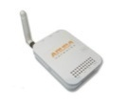





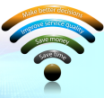

无所不在的无线校园网——上海交大案例介绍
网络中心
ChinaNet
CMCC
CUC
班车上的无线校园网
各个运营商
CPE接入设备
原有Cisco控制器
Aruba MMC6000
配置4个控制模块
（3+1冗余热备模式）
上海交通大学
边缘路由器
3G
千兆
千兆
Internet
Aruba
Airwave
校园IPv4/v6网络
家中的无线校园网
千兆
千兆
千兆
千兆
徐汇校区
无线网络
闵行校区
无线网络
PoE交换机
PoE交换机
PoE交换机
PoE交换机
无线网络终端
IPv4/v6双栈运行
笔记本电脑
智能终端
笔记本电脑
智能终端
笔记本电脑
智能终端
笔记本电脑
智能终端

Slide 30
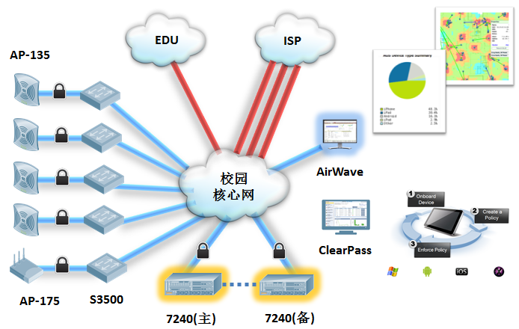
基于用户身份精确识别——汕头大学（李嘉诚基金会）
无线网络特点：
  同时监控与管理学校原有Cisco无线和有线网络；
  Aruba基于角色面向用户的网络设计；
  用户状态检测防火墙摆脱了基于IP 和VLAN 的管理，真正做到网随人动，策略永随。

Slide 31
Aruba竞争优势
Notes:
Hello everyone. I hope you are all excited and fired up as much as I am. Let me explain why we are here.
We have had a great 2010 and we are here to discuss what we need to do to achieve higher in 2011. There is a big shift in how enterprises are transforming the way they do business by relying more and more on mobile devices and applications. Enterprise mobility is what we do best. We have a recognized brand in the market place. As a company we have solid financials, a great team, solid products that just work. We are all very passionate about what we do, taking good care of our customers and supporting their enterprise mobility initiatives.
We have a great opportunity to build upon our thought leadership in the market place today when it comes to enterprise mobility, great opportunity to help our customers meet unique set of business objectives. But most importantly we have a great opportunity to sell more products and make more money.
But life is not that easy. We have talked to you about many of these new products in our last sales kickoff. I can assure you that it is not going to be a walk in the park to convince people to invest in these new products. But we believe that we have a great story to tell, and a damn good value proposition for any new and existing Aruba customer.
Two of the main obstacles you are going to be faced with are the following:
From new customers – Aruba is just a wireless LAN provider… what gives you the right to tell me how to design my access network?
From existing customers – Aruba was our choice for 802.11n wireless… aren’t you losing focus by releasing all these products for wired, remote, outdoor?
In order to help you counter these arguments, we have put our existing and new products into one new architecture, called MOVE – the access network architecture for Mobility, designed for the Mobile Virtual Enterprise. MOVE architecture will help IT organizations rightsize their access network spending for mobility and improve service delivery to their mobile workforce, while reducing risk. MOVE will help IT organizations divorce their access networking requirements from their core networking requirements, and take control in putting together a long term mobility strategy.
We have had the opportunity to share this MOVE architecture with some of the customers and analysts – feedback has been great – we have the mindshare and permission.
No better testament than Gartner… here is what the new MQ looks like.

Slide 32
Aruba MOVE™ 的差异化:
工业级，最可靠，最安全的解决方案
频谱资源的管理
自适应射频管理 (ARM)
集成频谱扫描
安全保护
集成无线入侵检测 (WIDS)
射频保护 RFProtect
BYOD & 情景感知
状态化的策略执行防火墙 (PEF)
用户，设备，应用，地点等多维因素的感知
流量管理，优先性设置和传输保证
管理 & 故障处理
支持多厂商和多架构
射频可见
综合保障
设备/用户访问接入的精简配置，定义与执行策略
统一的架构
智能频谱负载均衡

Slide 33
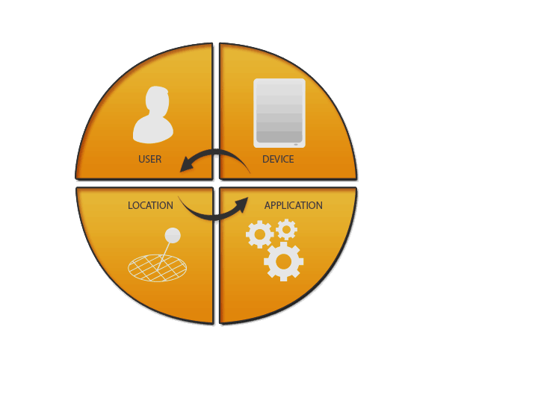
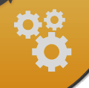

BYOD & 情景感知
用户，设备，应用，地点
用户身份的感知
基于角色的策略
用户级的可见性
设备类型的感知
自动注册
设备级的策略
基于端口/VLAN的感知
⊗ 有限的策略配置
⊗ 在大规模网络中难以扩展
⊗ 管理成本极高
应用的感知
应用级的QoS
设备高密度
传统解决方案
时间，地点的感知
策略配置的虚拟化
Notes:
The answer is simple and right in front of us.
If we want to control access to the network based on the mobile device choice of end users, the network itself needs to be device aware. The network should not treat all devices in one VLAN as the same – it should manage network access policies per device, not per VLAN.
If we want folks to use any enterprise application, including a custom iOS application that the IT department developed for employee training or Apple Facetime for easy video conferencing on iPhones, without worrying about performance, delay, latency, the network itself needs to be application aware. Manage bandwidth and quality of service per application, not per port, not per VLAN.
If we want different user groups to have access to different corporate resources based on their role within the organization and further enhance that access policy based on their mobile device of choice, the network needs to authorize access and apply network access rules based on the user identity, not based on the port they are connected to or the VLAN that they are a part of.
If we want to monitor and control access for enterprise users across the wired and wireless network, while allowing them to their jobs independent of where they are located or which port they are connected to, and just plug-n-play, the network needs to be available everywhere and not tied to a certain location.
Aruba MOVE for campus delivers exactly that. While traditional access networks are only aware of the VLAN and port that the user is connected to, Aruba MOVE can identify the end user device, automatically prioritize mission critical applications on any device, control access for users based on their role within the enterprise and allow plug-n-play access to corporate resources within inherent location based intelligence.
Looking at Cisco’s Borderless access network architecture what we see is port and VLAN awareness. Policies are implemented based on which VLANs users are associated to. This approach lacks user, device and application visibility increasing security risk… wired and wireless access network infrastructures are separate hence it is very complex and costly to support a large scale mobile infrastructure… and it is way too costly too manage due to multiple generations of different products being installed and managed separately.
On the other hand, we see a single network infrastructure for mobility with Aruba MOVE. Since it is user aware, enterprise IT can apply role based policies and enable full user visibility, reducing fragmentation of services, hence reducing risk. Since it is device aware, it allows for employee owned devices to be auto enrolled into the network with per device policies attached to each – without increasing support costs for IT. Since it is application aware, it allows for latest generation of mobile devices, such as smartphones and tablets, to simultaneously access multiple mission critical applications without service degradation, even in high density wireless environments. Since it is date and location aware, it allows IT managers to enable new services easily through the use of virtualized policy configuration.

Slide 34


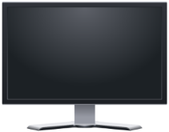
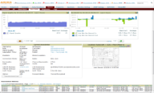









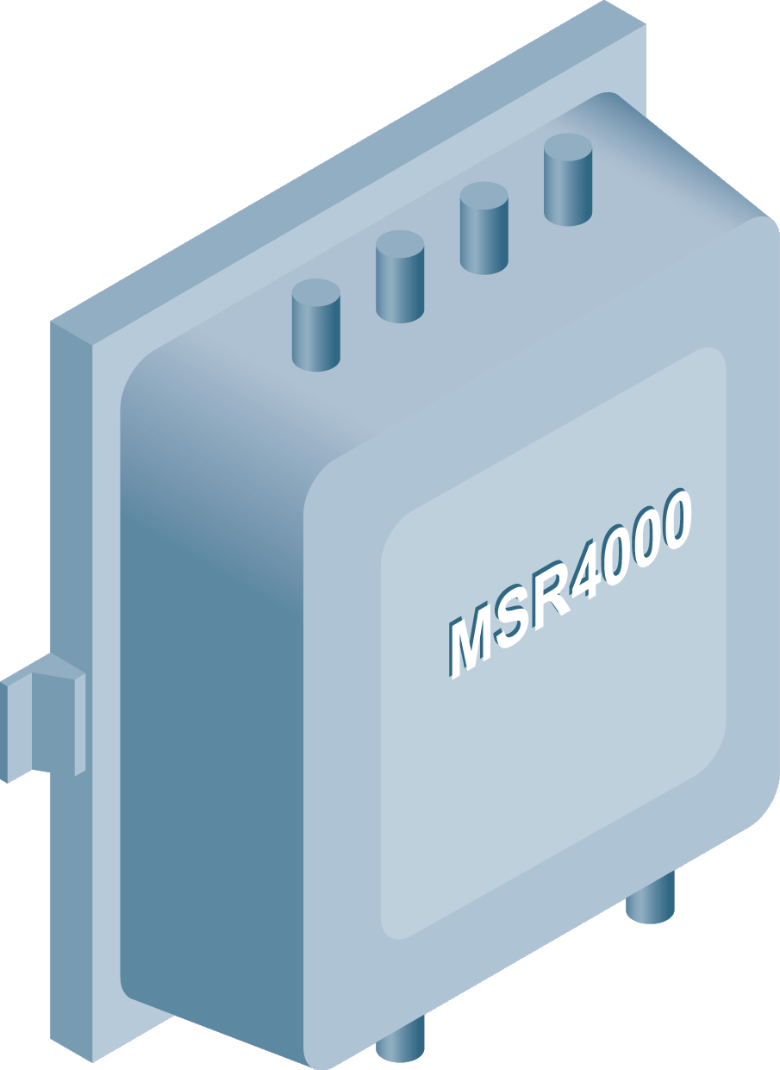
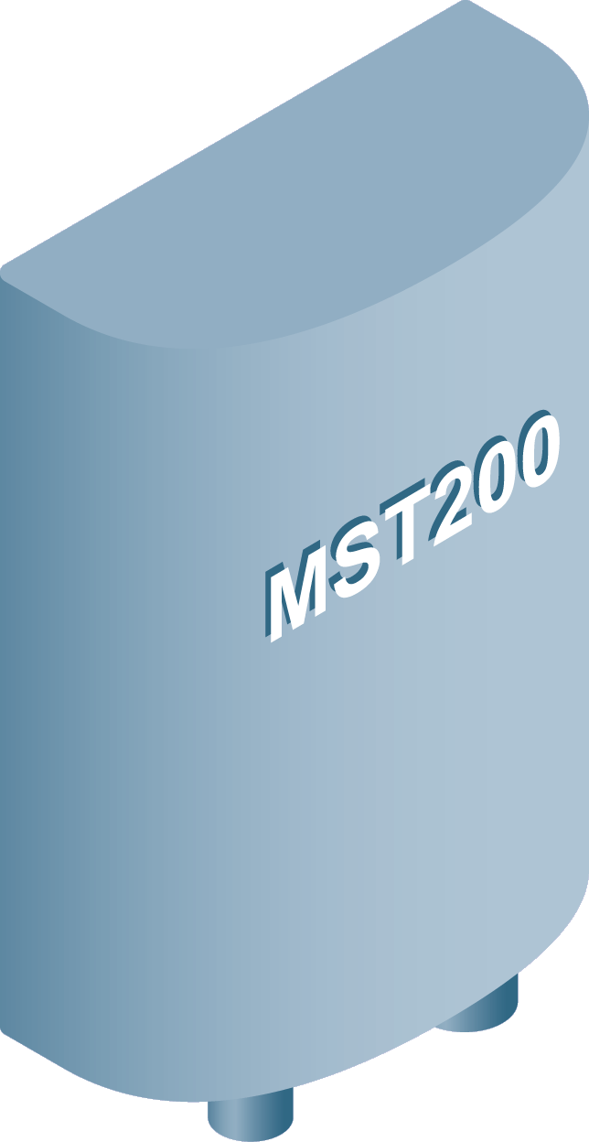



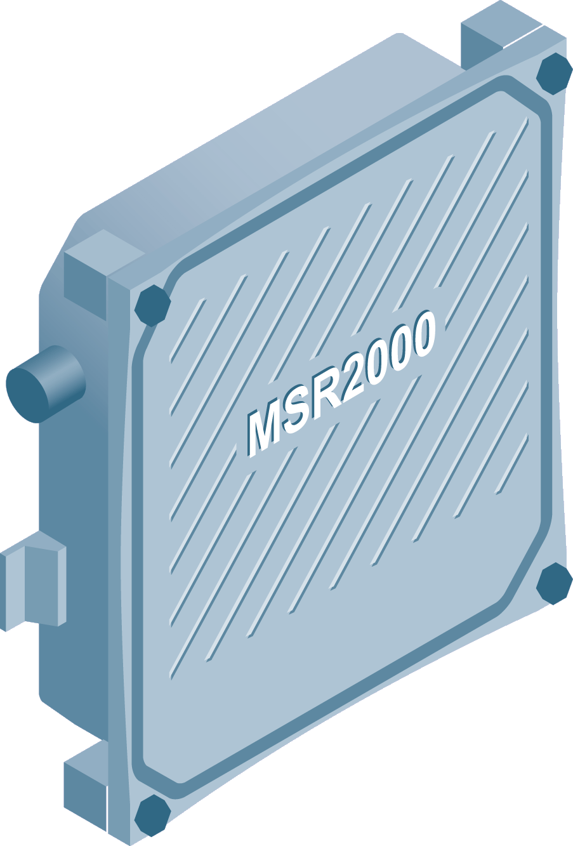
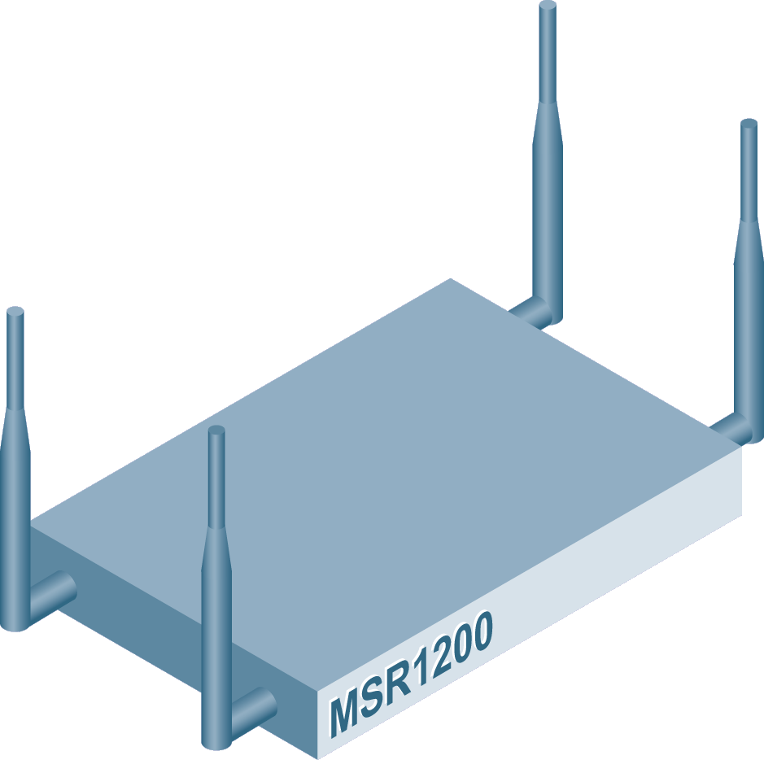
支持多厂商和多架构
AirWave(综合网管) & ClearPass(终端智能接入管理)
移动控制器
有线架构
无线接入点
用户 & 设备
户外 / MESH
Aruba
Aruba
Aruba
监控网络活动
Aruba AP175
Cisco
Motorola
HP
more
Aruba MDAC的分类与报告
集成MDM
Cisco
Juniper/Trapeze
Motorola
Meru
任何 MIB-II 的兼容设备
Aruba AirMesh
Notes:
Integrated architecture - requiring fewer number of servers reduces power consumption and operating costs
Multi-vendor (>20 wireless, wired, client devices)
Multi-architecture (thin and autonomous WLANs) support prevents vendor rip and replace
Multi-infrastructure support (wired, WLAN, mobile device) reduce costs spent on different NMS packages
Historic RF Trending information for debugging
Classifications, detected time, signal strength, duty cycle, affected channels
Noise floor, TX power, channel, errors over time
RF utilization including busy, sending, receiving and interference
RF Health reports
ConfigurableTriggers/Alerts on an RF anomaly
Best customer support in the industry, with direct access to level 3 and 4 support engineers
Continued product innovation with focus on quality of service across the entire network: wired, wireless and client device

Slide 35
谢 谢！

